Slide 1
Smart news
Find Your News

Slide 2
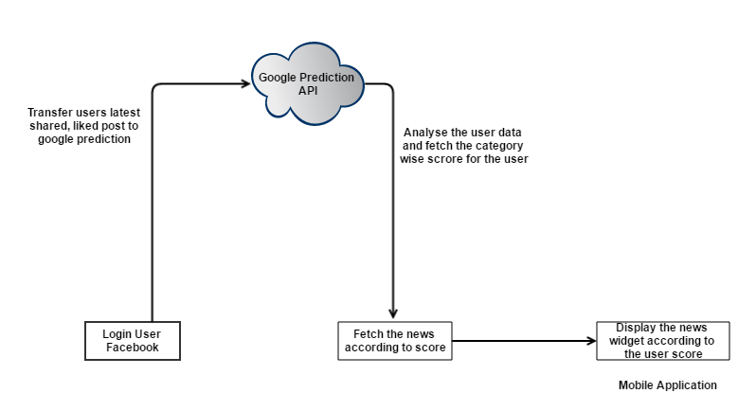
Architecture

Slide 3
User Point Of View
User will automatically get whatever the news he likes.
UI constructed with widgets, So the user can change the priority and all
User can view more user favourite news on the front page like his district news, his favorate game information.
News's are not specific to news to a single news paper. It also displayed according to analysis (If user likes Hindu news paper on his Facebook page. The app displays on that particular news paper related articles)

Slide 4
Application Owner Point of View
Can able to identify user specific tastes
Can able to put ads which related to particular user.
More downloads
Admin don’t care about what to post. Because it does by the system

Slide 5
Developer Point Of View
Hybrid Application (developed by using google prediction)
Backend created by using JAVA
Database Created by using MongoDB
Can use in any platform
The prediction is done by using google prediction api
Using material design

